Slide 1
Refund/Withdrawal Request
Refund – Submitted if COA has made error and need to return funds to clients account
Withdrawal – Submitted when a client is requesting funds from global (not an error)
🔹 Step 1: Understand the Request
Ask why the client wants to withdraw funds.
Explain that keeping funds in the account supports program success.
If they insist, continue.
🔹 Step 2: Verify Funds
Confirm funds are available in the Global account.
🔹 Step 3: Check for Settlements
Use the calc to find the lowest amount the client can withdraw without impact.
If $0.00 or less, any withdrawal will cause a negative impact.
  Client can:
    Set up a draft to replace funds, or
    Proceed without replacing funds (settlements will be lost).
EMT RFSS request is required for EACH settlement if funds won’t be replaced.
🔹 Step 4: Submit Request
Request Type: Refund/Withdrawal
Responder: Your name
Internal Status:
    Waiting on Responder
Next Global Occurrence: Today’s date
Request Field Notes: Include impact disclosure + EMT RFSS info
🔹 Step 5: Final Steps – Follow UMA SOP for ALL refund/withdrawal requests.
Advise client: 3–5 business days for processing

Slide 2

Refund/Withdrawal Script
  “In order for us to accept verbal authorization, we need to record this call. Do I have permission to record your authorization for account number Global Account ID on today’s date?
  Now that this call is being recorded, can you please state your first and last name, date of birth, and last 4 digits of your Social Security number?
  Today you are requesting to withdraw $XXX from your Global Holdings account, back to your personal account ending in last 4 digits of your personal bank account.
  *If no settlements in place* You also acknowledge that by moving this draft, the negotiations process may be delayed until funds are once again available. Please state Yes if you agree.
  *If settlements in place* You also acknowledge that by moving this draft your current settlement(s) with list each account currently in settlement may be negatively impacted if there are not enough funds in your Global Holdings account to make the next creditor payments. We will pause further negotiations of your remaining accounts until your currently scheduled fees are paid in full. In addition, we will attempt to resettle these accounts once all other accounts are in settlement and funds are built back up. Please state Yes if you agree.
  Do you authorize the withdrawal from your Global Holdings account for the amount mentioned?”

Slide 3
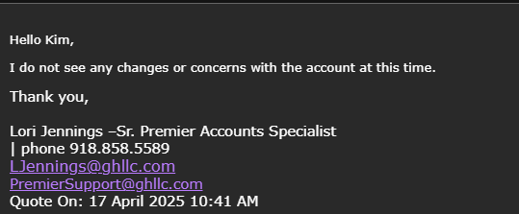
Refund/Withdrawal Request
  If client is requesting to withdraw more than $500:
  Agent will fill out the withdraw request and set it as "Waiting for Responder" Do not send it to accounting yet.
  Agent needs to request UMA from manager. Follow UMA process.
  Once the manager completes the approval, they will upload the advantage point URL to the Quickbase original refund/withdrawal request notes.
  Change Internal Status to "Waiting on Accounting"
  Save Request
  **Additional information:
  TL will have to complete the recording if $501-1500 and the manager will have to do the recording for $1501+
  ***If the withdrawal request is over $5,000, the manager will need to email GH "Premier Support" <premiersupport@ghllc.com> to confirm no red flags on the account that will hold up the withdrawal.
  Example of Email:
  Dear Premier Support Team,
  I hope this message finds you well.
  I am reaching out to inform you that CLIENT NAME is requesting to withdraw $5,000 from their Global Holdings account. Before we proceed, we would like to check in and ensure there are no red flags or issues associated with this account that we should be aware of.
  Client Global ID: CLIENTS GLOBAL ID NUMBER
  Please let us know If there is anything that would prevent or delay this transaction
  Example of response if no red flags:

